Slide 1

RISK CATEGORIZATION OF EUROPEAN BANKS
GROUP 5 :
1.JYOTHEESWAR ADHI
2. SWETHA
3.JASMINE DAS
4.SAI POOJA
5.GUNALAN

Slide 2
PROBLEM STATEMENT:
Banks make profits using depositor’s money. Any losses will affect the customer’s deposits. Hence, Banks will not be able to pay back the customer. These losses depend upon the risk profile of the banks.
Solution:
Classifying banks based on their risk profile.

Slide 3
ABOUT DATASET:
Taken from European banking authority site. It is a detailed bank-by-bank data for 131 banks across 27 countries of the European Union (EU) and the European Economic Area (EEA). The data, is obtained for 4 quarters( 30 September 2018, December 2018, 31 March 2019 and 30 June 2019). The number of rows is 146257.
FEATURES:
NSA: ISO code of the bank’s country.
LEI_CODE: The Legal Entity Identifier (LEI) is used as a bank’s identifier.
LABEL: Method of Measure (Only original risk exposure is taken)
ITEM: Code of the Label.
PERIOD: Time period of financial transaction. Expressed as quarterly.
COUNTRY_RANK : Country’s rank based on credit rating.
PORTFOLIO: Approach followed while assessing the risk amount of banks.

Slide 4
FEATURES:
COUNTRY: The country of the legal entity to which the bank is lending money.
EXPOSURE: The entity which is borrowing money Ex: bank, financial institution, corporates etc.) (These are ranked)
STATUS: Defaulted asset/ non-defaulted asset.
PERF_STATUS: Performing/non performing asset.
CREDIT RISK AMOUNT : The Highest probable loss due to credit risk.
MARKET RISK AMOUNT : The Highest probable loss due to fluctuations of market price of assets.
TOTAL LEVERAGE RATIO EXPOSURE: Measures a bank’s total assets and off-balance sheet items through a regulator-defined set of weights.
BANK OF CAPITAL RATIO: Capital Adequacy.

Slide 5
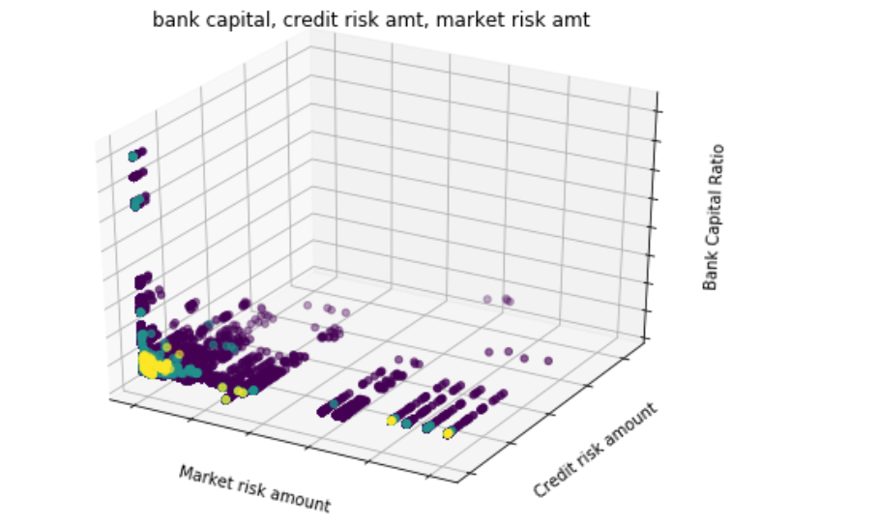
CLUSTERS

Slide 6
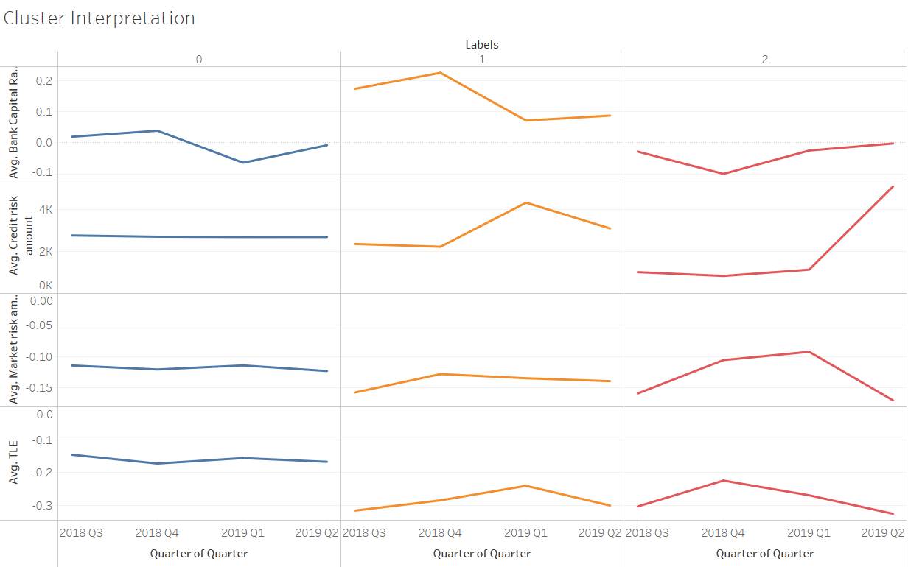

Slide 7
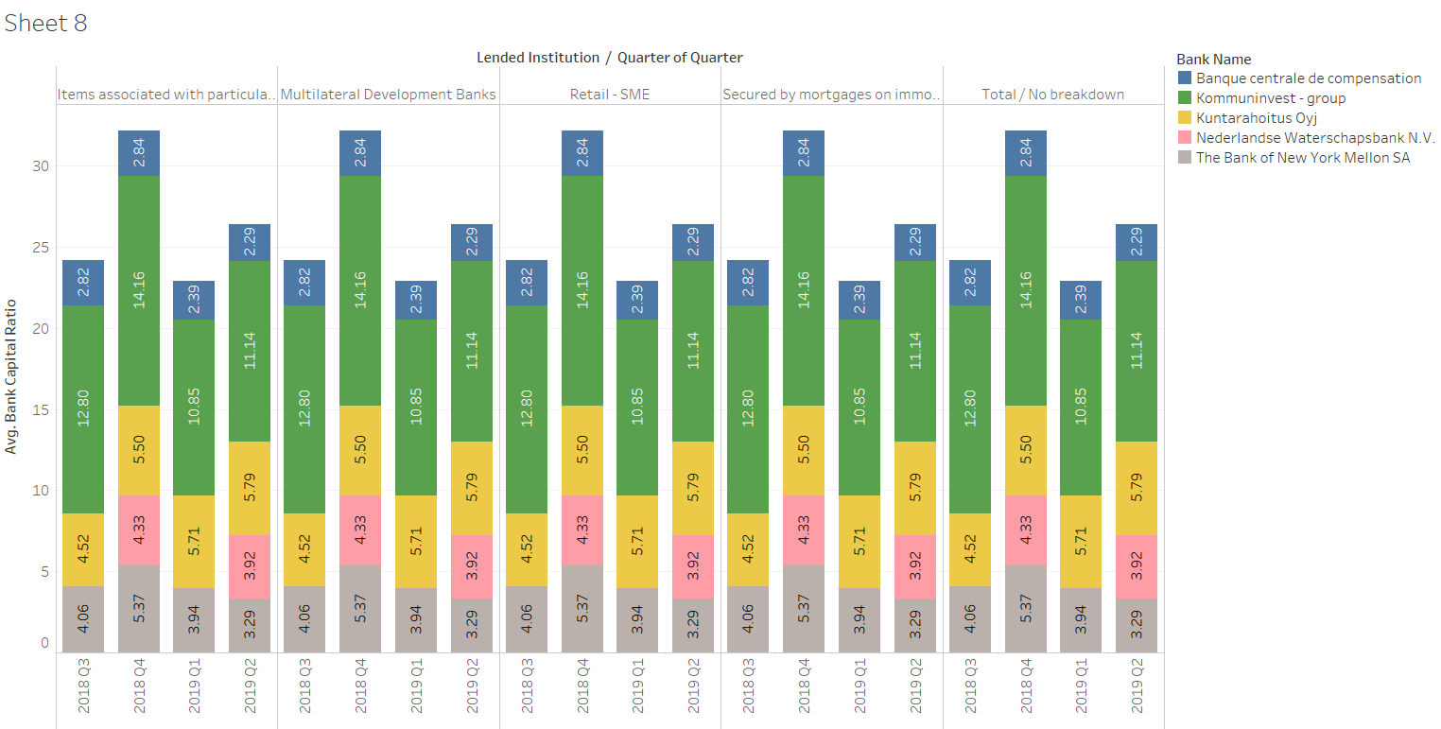
EDA

Slide 8
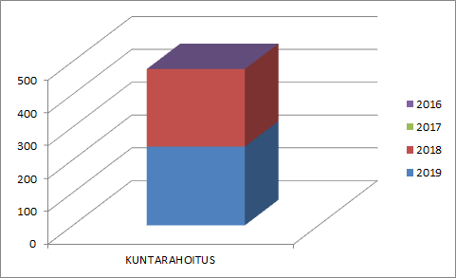
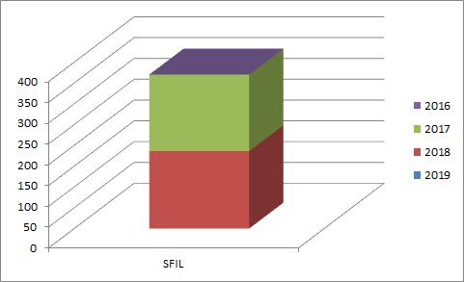
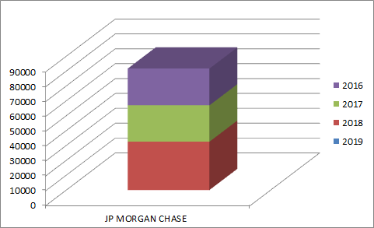
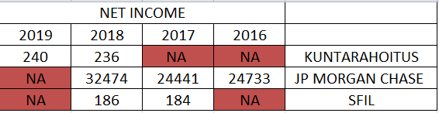
CHANGES IN INCOME
DATA TAKEN FROM THEIR RESPECTIVE ANNUAL REPORT

Slide 9
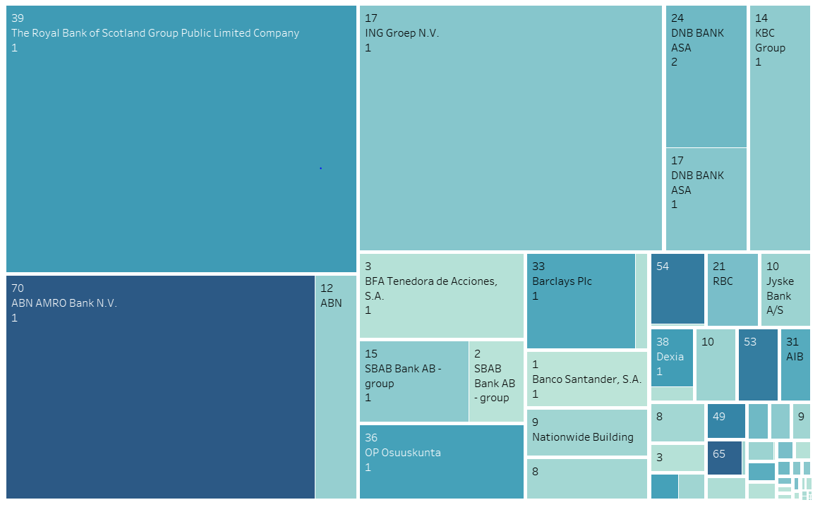
EDA :

Slide 10
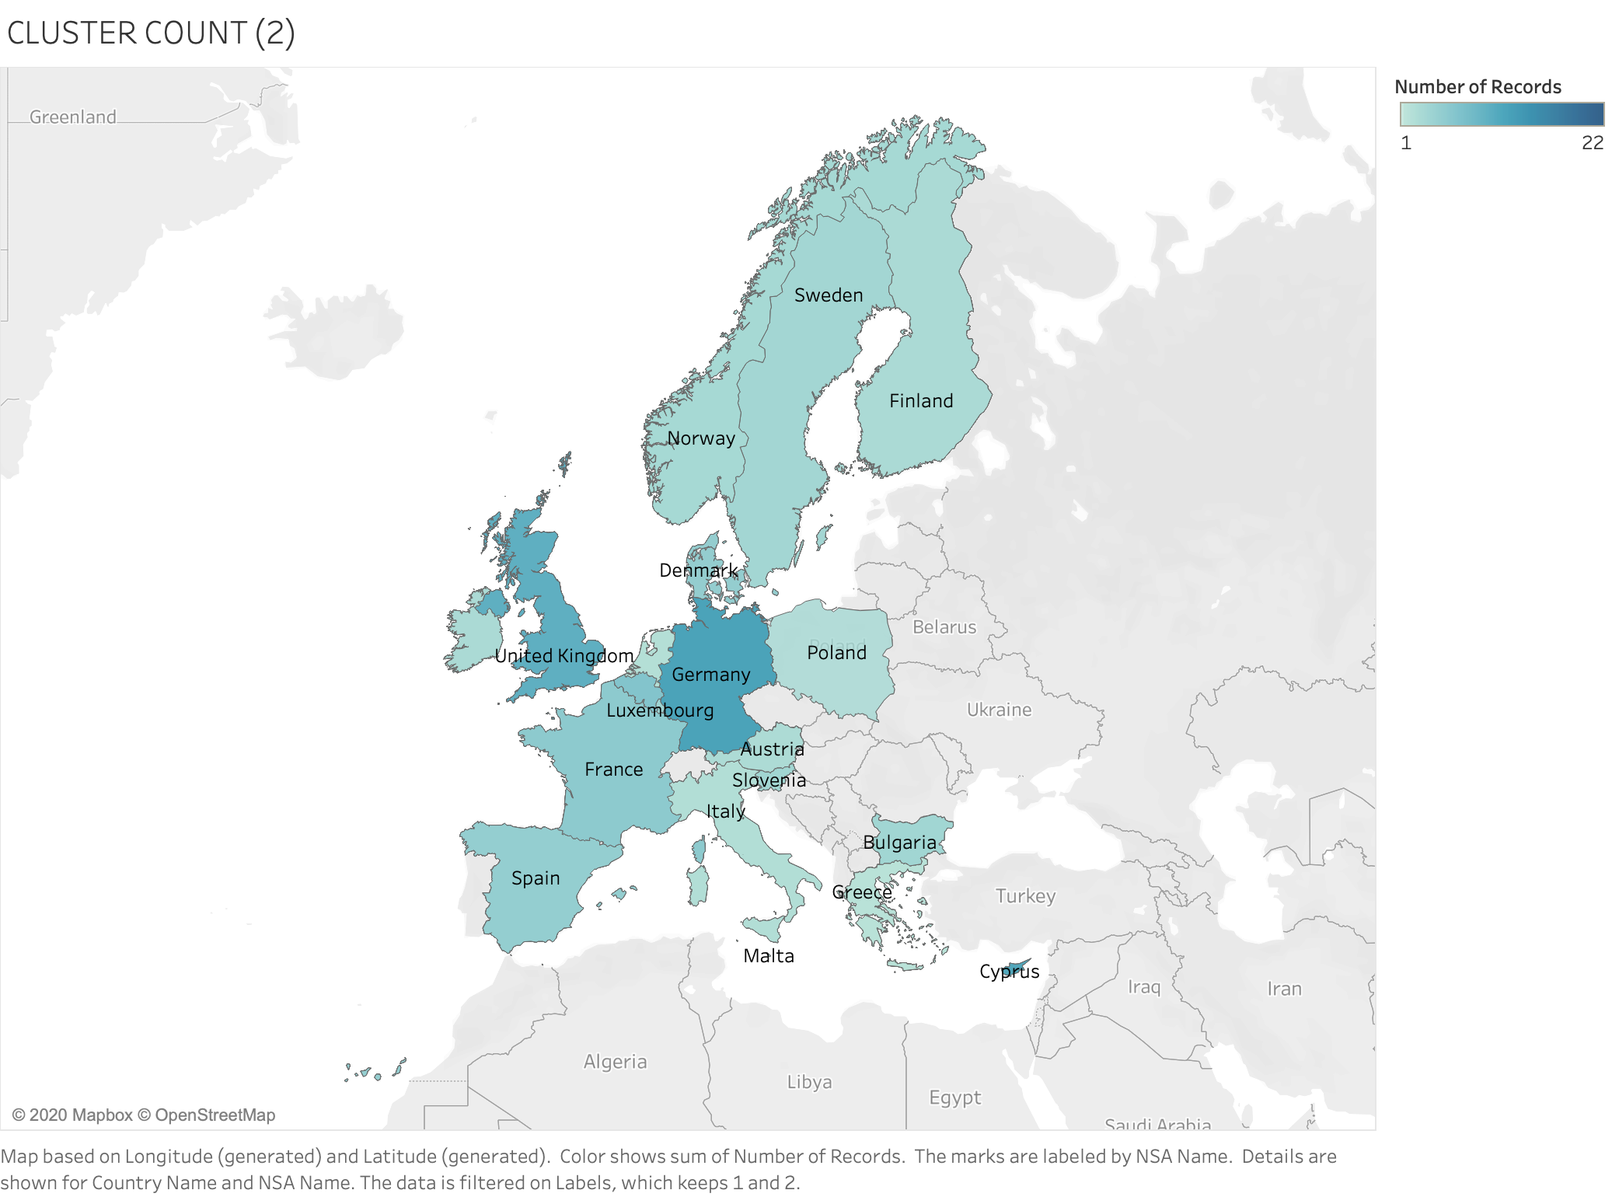
Country of bank with risky loans

Slide 11
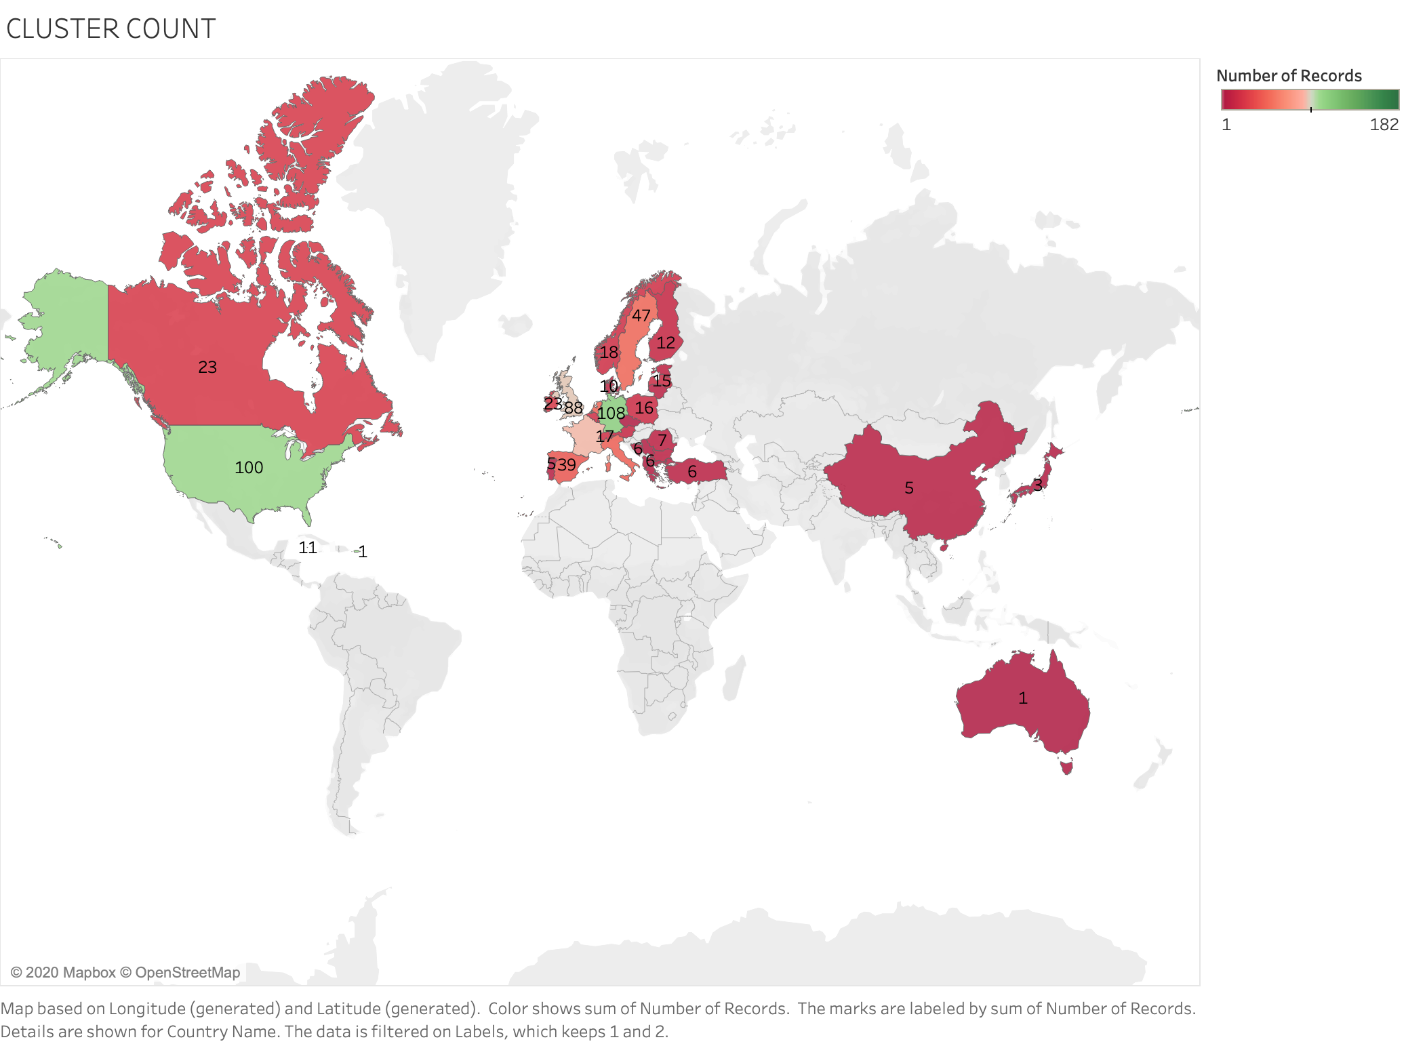
Destination country of risky loans

Slide 12
CLASSIFICATION MODELS
Model | Precision Score | Recall Score | Accuracy Score | f1-score
Decision Tree | 0.589108 | 0.567049 | 0.567049 | 0.555084
Decision Tree - Grid search | 0.962395 | 0.962458 | 0.962458 | 0.962421
k-nn | 0.932303 | 0.930664 | 0.930664 | 0.930136
random forest | 0.727699 | 0.724329 | 0.724329 | 0.706257
bagging classifier | 0.920797 | 0.921153 | 0.921153 | 0.92068
Extra tree classifier | 0.706657 | 0.706361 | 0.706361 | 0.688503
Ada boost classifier | 0.70442 | 0.702874 | 0.702874 | 0.703446
Xg BOOST classifier | 0.851764 | 0.852835 | 0.852835 | 0.851272

Slide 13
CONFUSION MATRIX
A C T U A L
18392 | 820 | 75
892 | 18207 | 99
110 | 179 | 1961
P
R
E
D
I
C
T
E
D
PRECISION | RECALL | F1-SCORE
0.95 | 0.95 | 0.95
0.95 | 0.95 | 0.95
0.99 | 0.99 | 0.99
ACCURACY : 0.96

Slide 14
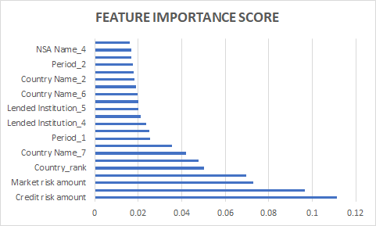
IMPORTANT FEATURES

Slide 15
REGRESSION MODELS
Model | Mean Squared Error | RMSE | R-squared test | R-squared train
Linear regression | 0.011237 | 0.106006 | 0.876989 | 0.876877
Random forest regressor | 0.000126 | 0.011208 | 0.998625 | 0.998546
Bagging regressor | 0.019105 | 0.138219 | 0.790868 | 0.844968
Bagging regressor with Grid Search CV | 0.029721 | 0.172399 | 0.674649 | 0.692826
XG boost | 0.000004 | 0.001987 | 0.999957 | 0.999959

Slide 16
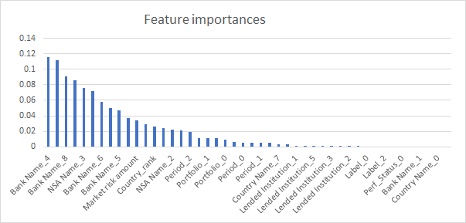
IMPORTANT FEATURES

Slide 17
CONCLUSION
Most of the Banks in Europe have very low risky assets and are therefore safe for deposits. However there are few banks that substantially larger risky assets compared to other banks. Those banks have been identified.
Further research:
A panel data regression to study effects of time on risk classification.
With sufficient historical data a time-series regression with ARIMA modelling can be run to predict the various risk exposure amounts of the banks.

Slide 18
THANK YOU

